Slide 1
IPL Data ANALYSIS
USING POWER BI
TASK 3 OF MENTORNESS INTERNSHIP
BY KRISHNA VAGHELA

Slide 2
INTRODUCTION
DATA OVERVIEW
PLAYER WISE ANALYSIS
TEAM WISE ANALYSIS
DASHBOARD

Slide 3
INTRODUCTION
We believe every team has dream of winning the final cup or trophy, the dream becomes their goal and that goal is achieved only by planned action for unfavourable scenarios.

Slide 4
Quick facts
IPL is professional Twenty20 cricket league in India contested during April and May of every year by teams representing Indian cities.
Founded by BCCI and it is now the most attended cricket league in the world.

Slide 5
Data overview
We have given four tables
dim_match_summary
dim_players
fact_bating_summary
fact_bowling_summary

Slide 6
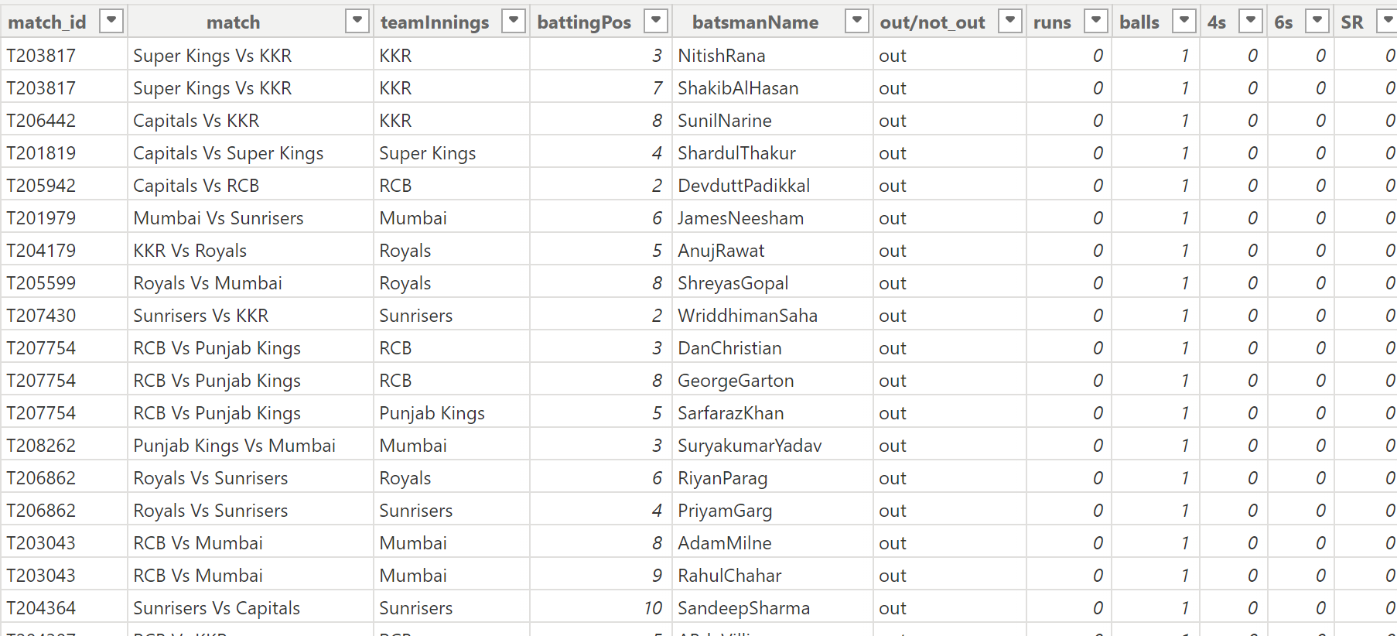
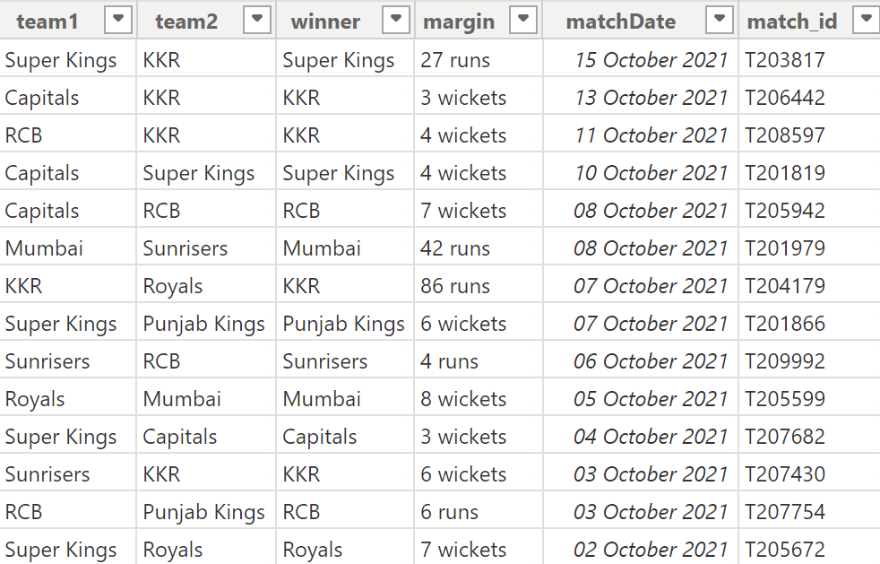
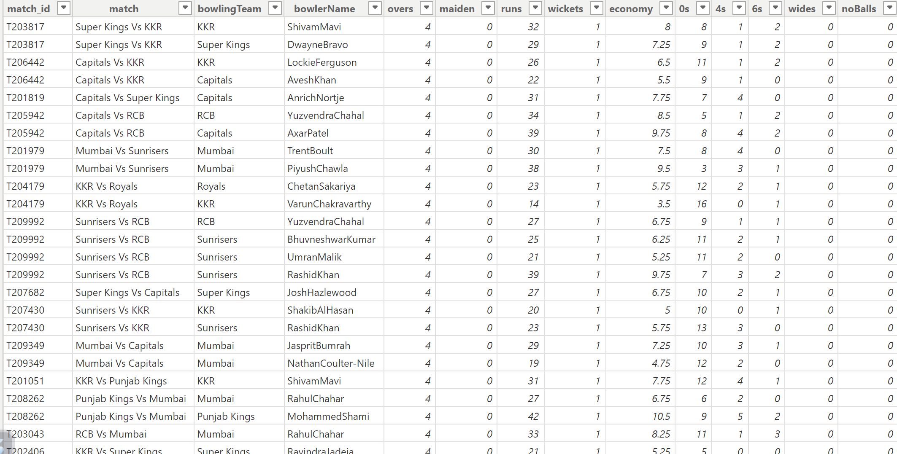
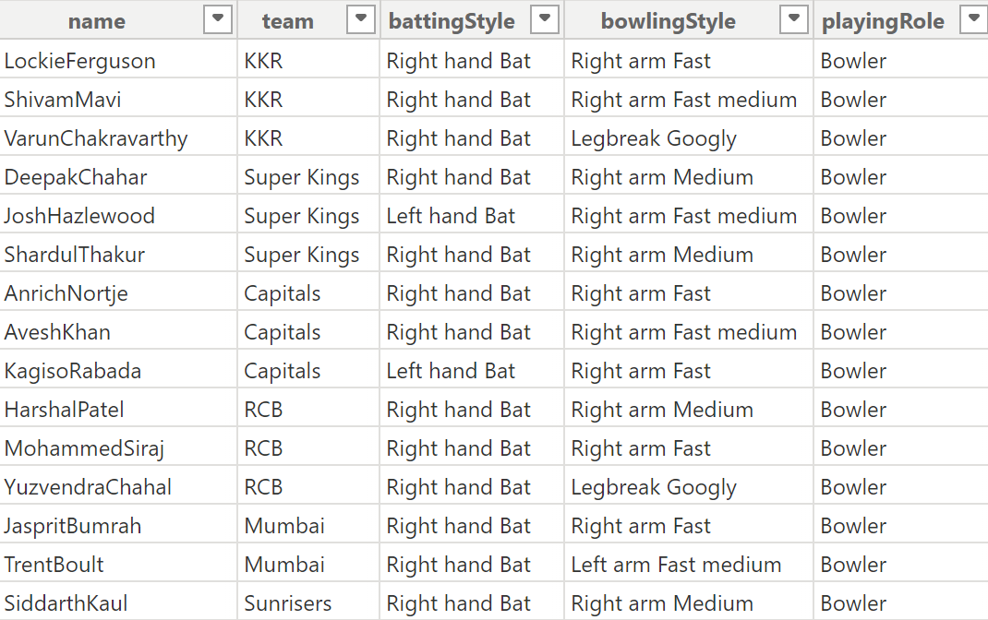
fact_bating_summary
dim_match_summary
fact_bowling_summary
dim_players

Slide 7
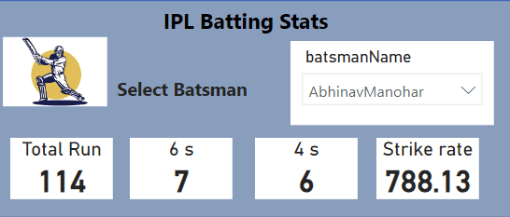
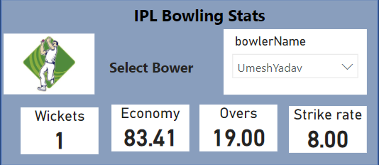
Player wise analysis

Slide 8
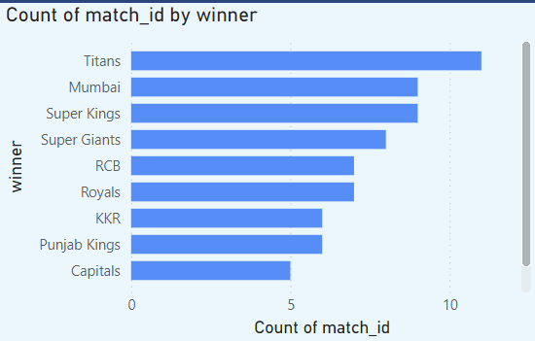
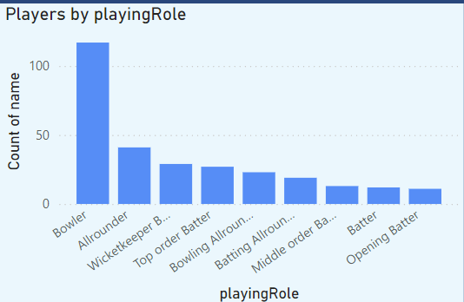
Team wise analysis

Slide 9
